Slide 1
Randomized Algorithms CS648
Lecture 19
Randomized Incremental Construction
(part II)

Slide 2
Randomized Incremental Construction

Slide 3
Homework of the last class
Theorem:
There exists a linear time Las Vegas algorithm
to compute closest pair of points in plane.
Note: We made an assumption
“Distance between each pair of points is distinct.”
Homework :
What will be the time complexity if we discard this assumption ?

Slide 4
Geometric Algorithms
Convex Hull of a set of points
Trapezoidal decomposition of a set of segments.
Smallest sphere enclosing a set of points.
Linear programming in finite dimensions.
Convex polytope of a set of half-planes

Slide 5

Trapezoidal decomposition
Report the segment just above a query point.
O($log n$) time

Slide 6


Trapezoidal decomposition
Time to build this decomposition
O($(n+m) log n$) deterministic time
O($m+n log n$) expected time

Slide 7
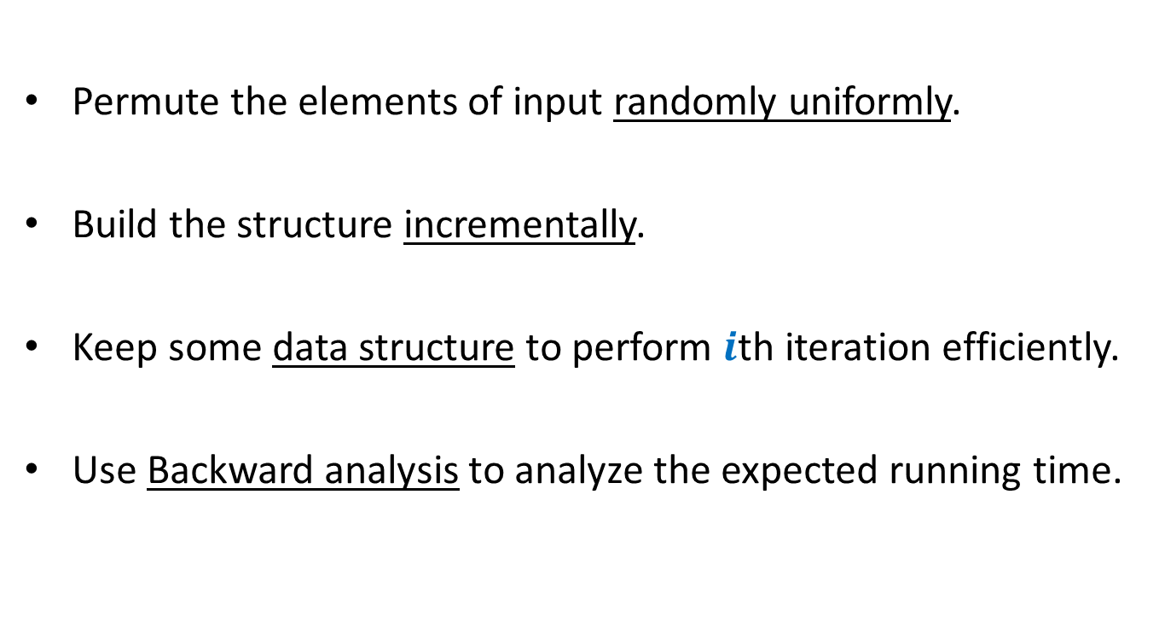
Randomized Incremental Construction
Permute the elements of input randomly uniformly.
Build the structure incrementally.
Keep some data structure to perform $i$th iteration efficiently.
Use Backward analysis to analyze the expected running time.

Slide 8

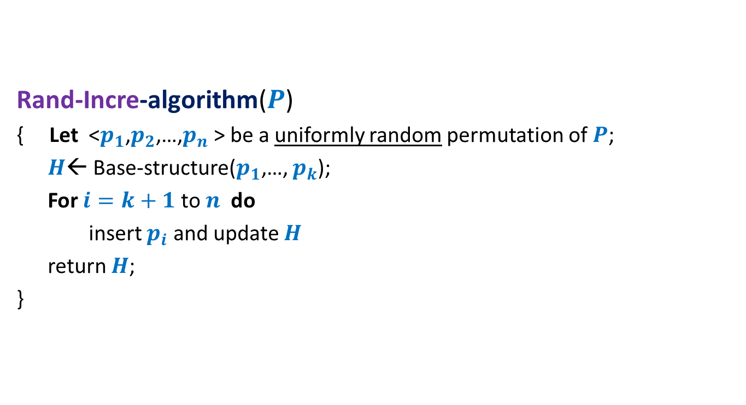
Randomized Incremental algorithm for a geometric problem
Rand-Incre-algorithm($P$)
{ Let <$p_{1}$,$p_{2}$,…,$p_{n}$ > be a uniformly random permutation of $P$;
$H$← Base-structure($p_{1}$,…, $p_{k}$);
For $i=k+1$ to $n$ do
insert $p_{i}$ and update $H$
return $H$;
}
$k$ : a very small constant
An efficient Data Structure
Conflict graph

Slide 9
problem 2 Convex hull of Points

Slide 10

Convex hull of Points
Problem definition:
Given $n$ points in a plane,
compute a convex polygon of smallest area that encloses all the points.

Slide 11
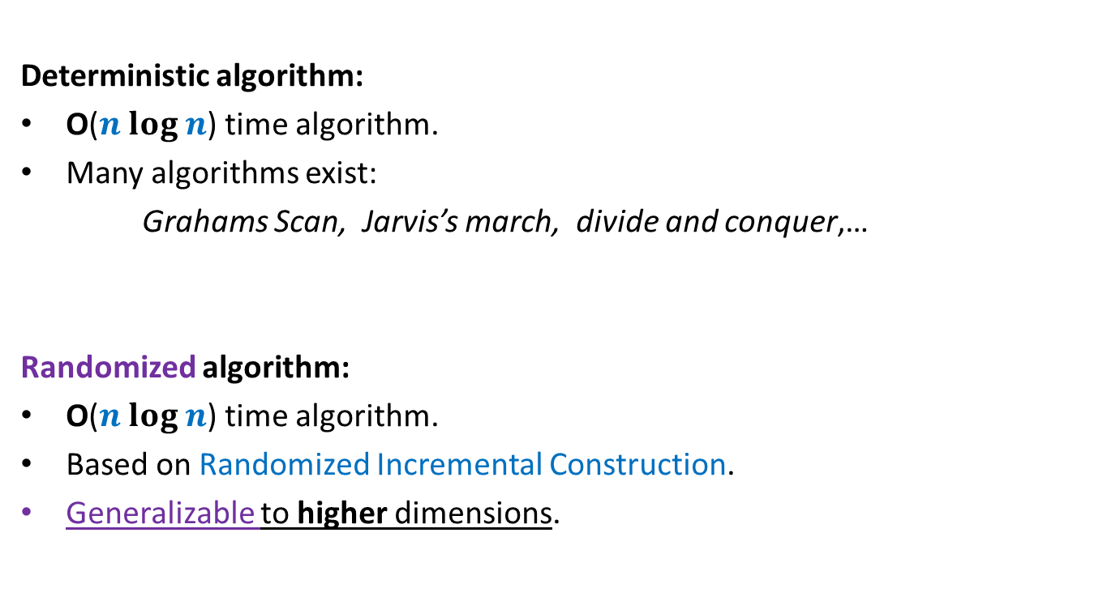
Convex hull of Points
Deterministic algorithm:
O($n log n$) time algorithm.
Many algorithms exist:
Grahams Scan, Jarvis’s march, divide and conquer,…
Randomized algorithm:
O($n log n$) time algorithm.
Based on Randomized Incremental Construction.
Generalizable to higher dimensions.

Slide 12
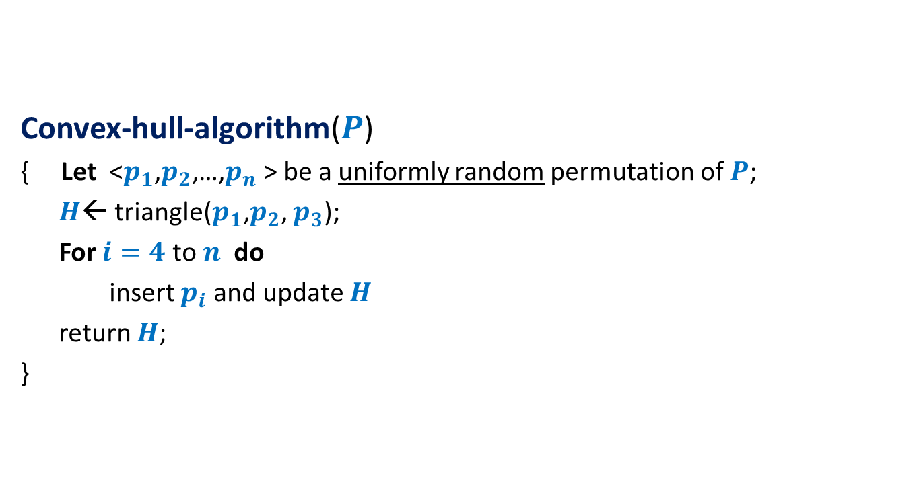
Randomized algorithm for convex hull
Convex-hull-algorithm($P$)
{ Let <$p_{1}$,$p_{2}$,…,$p_{n}$ > be a uniformly random permutation of $P$;
$H$← triangle($p_{1}$,$p_{2}$, $p_{3}$);
For $i=4$ to $n$ do
insert $p_{i}$ and update $H$
return $H$;
}

Slide 13






A simple exercise from geometry
Exercise: Given a line L and two points p and q,
determine whether the points lie on the same/different sides of L.
L
p
$$\left(x_{1},y_{1}\right)$$
O($1$) time
q
$$\left(x_{2},y_{2}\right)$$
q
$$\left(x_{1},{mx}_{1}+c\right)$$
$$y=mx+c$$
$$\left(x_{2},{mx}_{2}+c\right)$$

Slide 15

















Conflict graph : a powerful data structure
$$c_{2}$$
$n−i$points
cones
$$c_{1}$$
$$c_{1}$$
$$c_{8}$$
$$c_{3}$$
$$c_{2}$$
$$c_{3}$$
$$c_{4}$$
$$c_{5}$$
$$c_{7}$$
$$c_{4}$$
$$c_{6}$$
$$c_{7}$$
$$c_{8}$$
$$c_{5}$$
$$c_{6}$$

Slide 17




Before entering the for loop
$n−3$points
cones
$$c_{1}$$
$$c_{1}$$
$$c_{2}$$
$$c_{2}$$
$$c_{3}$$
$$c_{3}$$

Slide 18

Inserting $i$th POINt

Slide 19


$i$th iteration
$$c_{1}$$
$$c_{2}$$
$$c_{8}$$
$$c_{3}$$
$$c_{7}$$
$$c_{4}$$
$$c_{5}$$
$$c_{6}$$

Slide 20

$i$th iteration
$$c_{2}$$
$n−i+1$points
cones
$$c_{1}$$
$$c_{1}$$
$$c_{8}$$
$$c_{3}$$
$$c_{2}$$
$$c_{3}$$
$$c_{4}$$
$$c_{5}$$
$$c_{7}$$
$$c_{4}$$
$$c_{6}$$
$$c_{7}$$
$$c_{8}$$
$$c_{5}$$
$$c_{6}$$

Slide 21



$i$th iteration
$$c_{2}$$
$n−i+1$points
cones
$$c_{1}$$
$$c_{1}$$
$$c_{8}$$
$$c_{3}$$
$$c_{2}$$
$$p_{i}$$
$$c_{3}$$
$$p_{i}$$
$$c_{4}$$
$$p_{i}$$
$$c_{5}$$
$$c_{7}$$
$$c_{4}$$
$$c_{6}$$
$$c_{7}$$
$$c_{8}$$
$$c_{5}$$
$$c_{6}$$

Slide 22
$i$th iteration
$$c_{2}$$
$n−i+1$points
cones
$$c_{1}$$
$$c_{1}$$
$$c_{8}$$
$$c_{3}$$
$$c_{2}$$
$$c_{3}$$
$$c_{4}$$
$$c_{5}$$
$$c_{7}$$
$$c_{4}$$
$$c_{6}$$
$$c_{7}$$
$$c_{8}$$
$$c_{5}$$
$$c_{6}$$

Slide 23
$i$th iteration
$$c_{2}$$
$n−i$points
cones
$$c_{1}$$
$$c_{1}$$
$$c_{8}$$
$$c_{3}$$
$$c_{2}$$
$$c_{3}$$
$$c_{4}$$
$$c_{5}$$
$$c_{7}$$
$$c_{4}$$
$$c_{6}$$
$$c_{7}$$
$$c_{8}$$
$$c_{5}$$
$$c_{6}$$

Slide 24
$i$th iteration
$$c_{2}$$
$n−i$points
cones
$$c_{1}$$
$$c_{1}$$
$$c_{8}$$
$$c_{3}$$
$$c_{2}$$
$$c_{3}$$
$$c_{4}$$
$$c_{5}$$
$$c_{7}$$
$$c_{4}$$
$$c_{6}$$
$$c_{7}$$
$$c_{8}$$
$$c_{5}$$
$$c_{6}$$

Slide 25
$i$th iteration
$$c_{2}$$
$n−i$points
cones
$$c_{1}$$
$$c_{1}$$
$$c_{8}$$
$$c_{3}$$
$$c_{2}$$
$$c_{3}$$
$$c_{4}$$
$$c_{5}$$
$$c_{7}$$
$$c_{4}$$
$$c_{6}$$
$$c_{7}$$
$$c_{8}$$
$$c_{5}$$
$$c_{6}$$

Slide 26
$i$th iteration
$$c_{2}$$
$n−i$points
cones
$$c_{1}$$
$$c_{1}$$
$$c_{8}$$
$$c_{3}$$
$$c_{2}$$
$$c_{3}$$
$$c_{4}$$
$$c_{5}$$
$$c_{7}$$
$$c_{4}$$
$$c_{6}$$
$$c_{7}$$
$$c_{8}$$
$$c_{5}$$
$$c_{6}$$

Slide 27


$i$th iteration
$$c_{2}$$
$n−i$points
cones
$$c_{1}$$
$$c_{1}$$
$$c_{8}$$
$$c_{3}$$
$$c′$$
$$c_{2}$$
$$c_{3}$$
$$c_{4}$$
$$c_{5}$$
$$c_{7}$$
$$c_{4}$$
$$c_{6}$$
$$c"$$
$$c_{7}$$
$$c_{8}$$
$$c_{5}$$
$$c_{6}$$

Slide 28




$i$th iteration
$n−i$points
cones
$$c_{1}$$
$$c_{1}$$
$$c_{8}$$
$$c′$$
$$c′$$
$$c"$$
$$c_{7}$$
$$c_{6}$$
$$c"$$
$$c_{7}$$
$$c_{8}$$
$$c_{6}$$

Slide 29
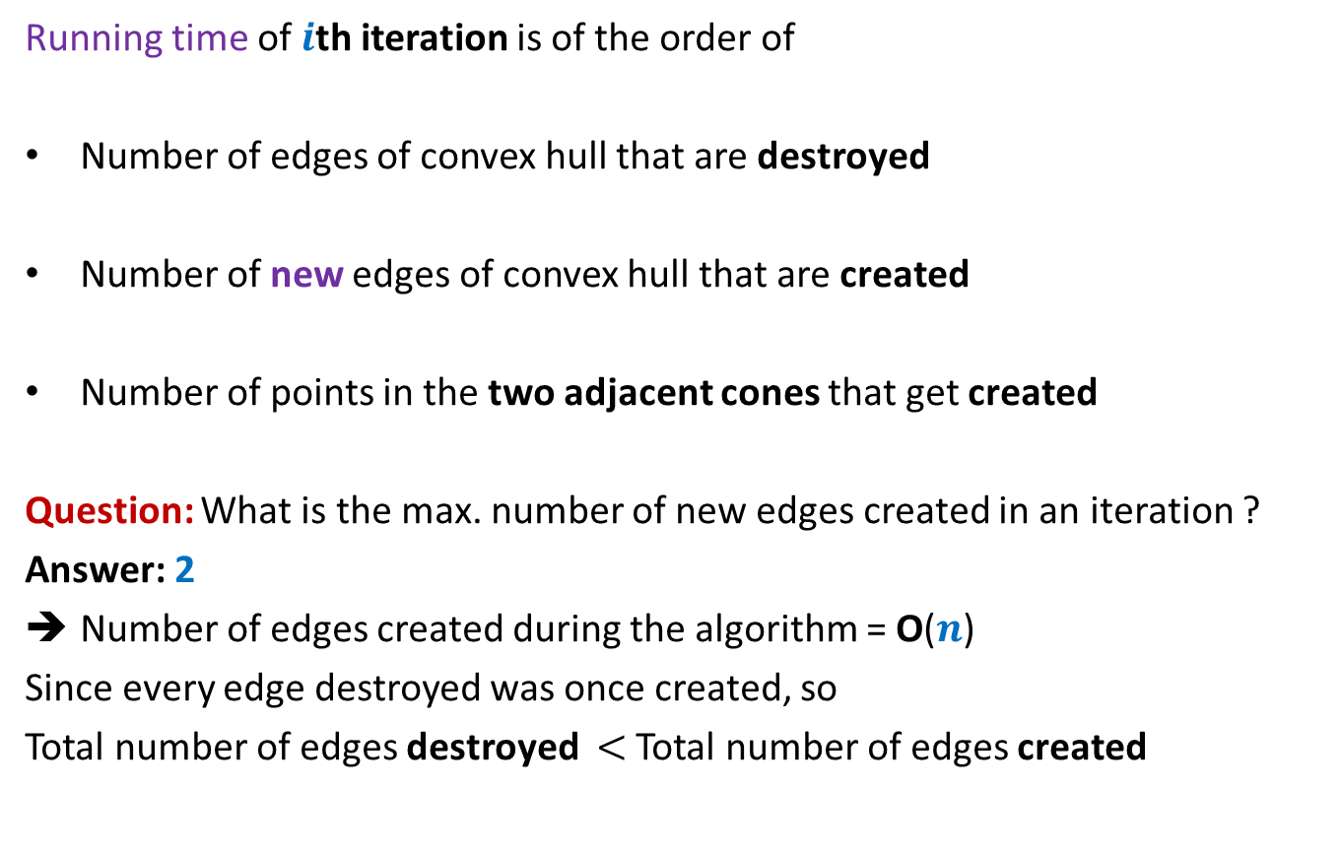


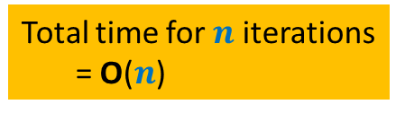
Running time of $i$th iteration
Running time of $i$th iteration is of the order of
Number of edges of convex hull that are destroyed
Number of new edges of convex hull that are created
Number of points in the two adjacent cones that get created
Question: What is the max. number of new edges created in an iteration ?
Answer: 2
Number of edges created during the algorithm = O($n$)
Since every edge destroyed was once created, so
Total number of edges destroyed $<$ Total number of edges created
Total time for $n$iterations
= O($n$)
$$X_{i}$$

Slide 30



Backward analysis of $i$th iteration
$a$ : a subset of $i$ points from $P$.
$𝓔_{a}$: first $i$ points of $P$ are some permutation of $a$
${E[X}_{i} \left|{ 𝓔}_{a}\right)$ = ??
Convex hull
at the end of $i$th iteration

Slide 31









Backward analysis of $i$th iteration
$a$ : a subset of $i$ points from $P$.
$𝓔_{a}$: first $i$ points of $P$ are some permutation of $a$
${E[X}_{i} \left|{ 𝓔}_{a}\right)$ = ??
$$c_{1}$$
$$c_{2}$$
$$c_{8}$$
$$p_{1}′$$
$$c_{3}$$
$$p_{8}′$$
$$p_{2}′$$
$$p_{7}′$$
$$p_{3}′$$
$$c_{7}$$
$$c_{4}$$
$$p_{4}′$$
$$p_{6}′$$
$$p_{5}′$$
$$c_{5}$$
$$c_{6}$$

Slide 32





Backward analysis of $i$th iteration
$a$ : a subset of $i$ points from $P$.
$𝓔_{a}$: first $i$ points of $P$ are some permutation of $a$
${E[X}_{i} \left|{ 𝓔}_{a}\right)$ = ??
$$c_{1}$$
$$c_{2}$$
$$c_{8}$$
$$p_{1}′$$
$$c_{3}$$
$$p_{8}′$$
$$p_{2}′$$
$$p_{7}′$$
$$n_{1}+n_{2}$$
$$p_{3}′$$
$$c_{4}$$
$$n_{2}+n_{3}$$
$$c_{7}$$
$$n_{3}+n_{4}$$
$$p_{4}′$$
$$p_{6}′$$
$$n_{4}+n_{5}$$
$$p_{5}′$$
$$c_{5}$$
$$c_{6}$$

Slide 33






Backward analysis of $i$th iteration
$a$ : a subset of $i$ points from $P$.
$𝓔_{a}$: first $i$ points of $P$ are some permutation of $a$
${E[X}_{i} \left|{ 𝓔}_{a}\right)$ = ??
$$c_{1}$$
$$c_{2}$$
$$c_{8}$$
$$p_{1}′$$
$$c_{3}$$
$$p_{8}′$$
$$p_{2}′$$
$$n_{1}+n_{2}$$
+
$$\frac{1}{i}$$
$$p_{7}′$$
$$p_{3}′$$
+
$$n_{2}+n_{3}$$
+
$$\frac{1}{i}$$
$$c_{7}$$
$$c_{4}$$
+
$$n_{3}+n_{4}$$
+
$$\frac{1}{i}$$
$$p_{4}′$$
+
$$p_{6}′$$
$$n_{4}+n_{5}$$
+
$$\frac{1}{i}$$
$$p_{5}′$$
$$c_{5}$$
+
$$c_{6}$$
+
$$\frac{1}{i}$$
$$n_{7}+n_{8}$$
+
$$n_{8}+n_{1}$$
+
$$\frac{1}{i}$$

Slide 34
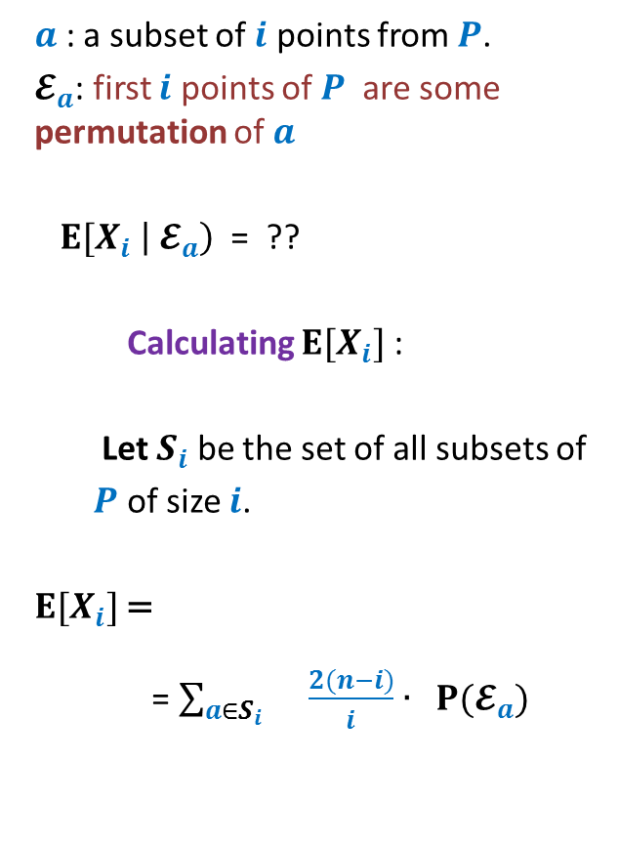

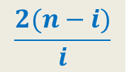
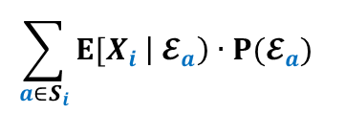
Backward analysis of $i$th iteration
$a$ : a subset of $i$ points from $P$.
$𝓔_{a}$: first $i$ points of $P$ are some permutation of $a$
${E[X}_{i} \left|{ 𝓔}_{a}\right)$ = ??
Calculating ${E[X}_{i}]$ :
Let $S_{i}$ be the set of all subsets of
$P$ of size $i$.
${E[X}_{i}]$=
= $\sum_{a∈S_{i} }{\frac{2(n−i)}{i}∙ P(𝓔_{a}) }$
$$c_{1}$$
$$c_{2}$$
$$c_{8}$$
$$p_{1}′$$
$$c_{3}$$
$$p_{8}′$$
$$\frac{2(n−i)}{i}$$
$$p_{2}′$$
$$p_{7}′$$
$$p_{3}′$$
$$c_{7}$$
$$c_{4}$$
$$p_{4}′$$
$$p_{6}′$$
$$\sum_{a∈S_{i}}{{E[X}_{i} \left|{ 𝓔}_{a}\right)∙P(𝓔_{a}) }$$
$$p_{5}′$$
$$c_{5}$$
$$c_{6}$$
= $\frac{2(n−i)}{i}$

Slide 35
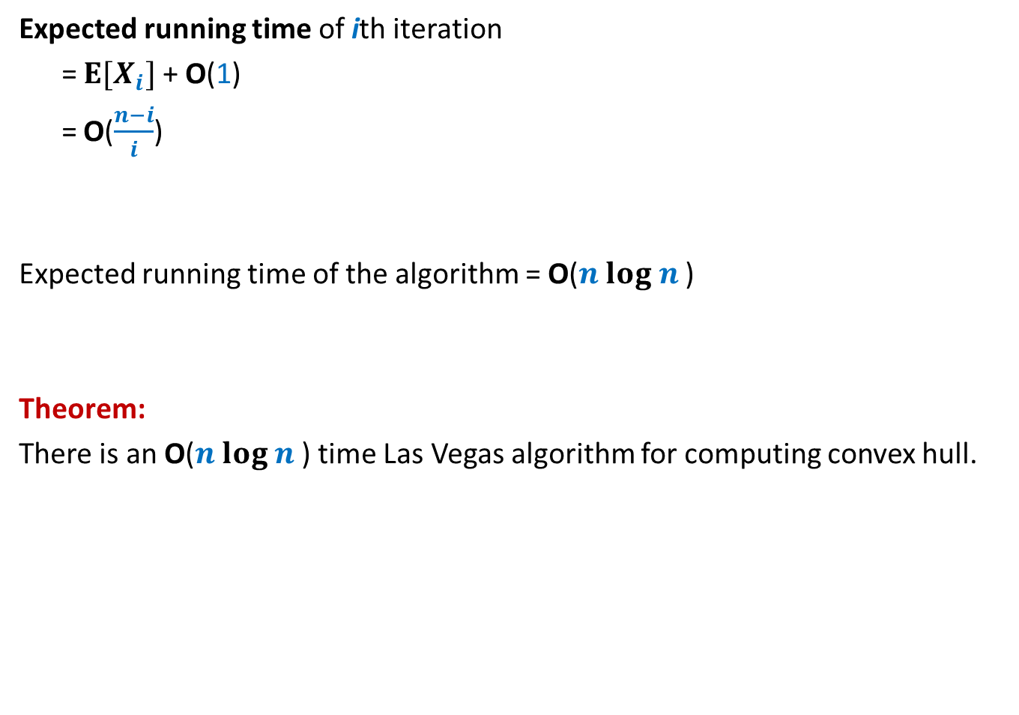
Running time of the algorithm
Expected running time of ith iteration
= ${E[X}_{i}]$ + O(1)
= O($\frac{n−i}{i}$)
Expected running time of the algorithm = O($n log n$)
Theorem:
There is an O($n log n$) time Las Vegas algorithm for computing convex hull.

Slide 36
USING Backward analysis for Miscellaneous Applications

Slide 37
problem 3 SMALLEST Enclosing circle

Slide 38
Smallest Enclosing Circle

Slide 39


Smallest Enclosing Circle
Question:
Suppose we sample $k$ points randomly uniformly from a set of $n$points,
what is the expected no. of points that remain outside the smallest circle
enclosing the sample?
For $k$= $\frac{n}{2}$, the answer is $<10$

Slide 40

Smallest Enclosing Circle
Let $C$ be smallest enclosing circle for set $P$ of point.
Facts from high school geometry
$C$ is defined by 2 or 3 points lying on its boundary.

Slide 41
Smallest Enclosing Circle
Let $C$ be smallest enclosing circle for set $P$ of point.
Facts from high school geometry
$C$ is defined by 2 or 3 points lying on its boundary.
Not the smallest enclosing circle
Since the defining points form
an obtuse triangle.

Slide 42
Smallest Enclosing Circle
Let $C$ be smallest enclosing circle for set $P$ of point.
Facts from high school geometry
$C$ is defined by 2 or 3 points lying on its boundary.
This is the smallest enclosing
Circle since the defining points
form an acute angle triangle.

Slide 43

Smallest Enclosing Circle
Let $C$ be smallest enclosing circle for set $P$ of point.
Facts from high school geometry
$C$ is defined by 2 or 3 points lying on its boundary.
Lemma 1: If $p$ lies outside $C$,
$p$ must be one of the defining point of smallest enclosing circle of $P∪\{p\}$

Slide 44
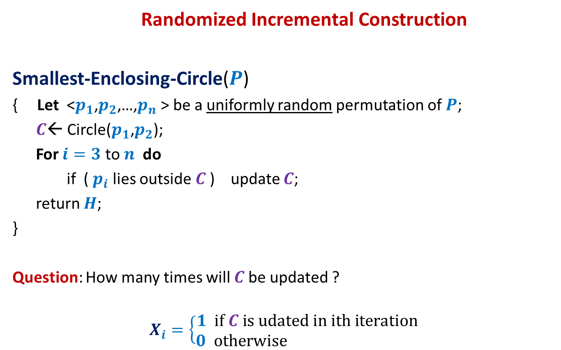
Smallest Enclosing Circle
Randomized Incremental Construction
Smallest-Enclosing-Circle($P$)
{ Let <$p_{1}$,$p_{2}$,…,$p_{n}$ > be a uniformly random permutation of $P$;
$C$← Circle($p_{1}$,$p_{2}$);
For $i=3$ to $n$ do
if ( $p_{i}$ lies outside $C$) update $C$;
return $H$;
}
Question: How many times will $C$be updated ?
$$X_{i}=\left\{\begin{aligned}1 if C is udated in ith iteration \\ 0 otherwise \end{aligned}\right.$$
?

Slide 45


Smallest Enclosing Circle
Question: What is P[$X_{i}=1$] ?
Smallest Enclosing Circle
at the end of $i$th iteration

Slide 46
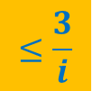

Smallest Enclosing Circle
$$≤\frac{3}{i}$$
Question: What is P[$X_{i}=1$] ?
Use it to solve the given problem.
Use Lemma 1

Slide 47
Birthday Paradox

Slide 48
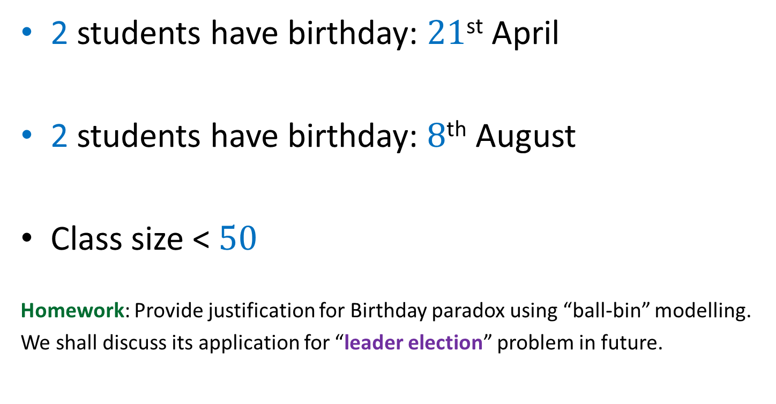
Result from the last class
2 students have birthday: $21$^{st} April
2 students have birthday: $8$^{th} August
Class size < $50$
Homework: Provide justification for Birthday paradox using “ball-bin” modelling.
We shall discuss its application for “leader election” problem in future.

